Slide 1
Learning Unit Development
WP2 T3

Slide 2
Learning Objectives
Develop a learning unit plan
Design learning content
Define assessment strategy

Slide 3
Agenda
Rich learning experience
Learning unit plan
Quizzes
Learning content
Activities

Slide 4
Learner-centric effective learning experience
Inquiry-based learning structures
E.g. projects and performance tasks
Thoughtfully interwoven direct instruction
Opportunities to practice and apply learning
Units should be well structured
balanced cognitive load
multiple modalities (VARK)
tools for accessing information
support different types of learners

Slide 5
Learning Unit Plan
How to use teaching methods and the learning content together with activities to achieve the defined learning objectives
effective lesson plan for online trainees vs traditional workshop
Detailed step-by-step guide for a trainer to understand
what materials to give to students
how to provide them
so students would accomplish their learning goals

Slide 6
HUNTER MODEL
Set learning objectives
Identify needs
Plan
Hook
Instruct
Practice
Wrap-up
Evaluate
Reflection

Slide 7
Learning Unit Plan Elements
Unit Name
Purpose of the unit
Location
Duration
Number of attendees
Learning objectives
Plan
topic, duration, key points, teaching methods, activities and resources
Assessment
Certification
Reflection

Slide 8
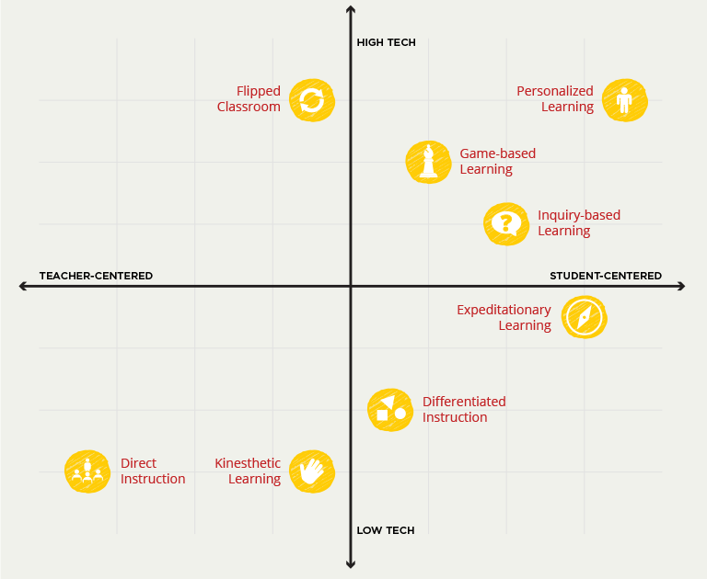
Teaching Methods
Image by edX from teach.com, © 2U

Slide 9
A learning unit plan
Analyse the Example Learning Plan that has been created for one of the learning units that are part of this training.
Are you able to prepape a learning unit plan for the identified units in your Open Science training?

Slide 10
Learning Content: Learner’s Notebook
brief introduction
learning objectives
target audience
duration
prerequisites
learning tools
content
summary
suggested reading

Slide 11
Learning Content: Slide Deck
Title slide
introduction (trainers and trainees)
Housekeeping information
Learning Objectives
Training Outline
Training Topic
Information
Example
Guided activity
Wrap up
Key takeaways
Final Q&A
Assessment information
Feedback gathering

Slide 12
Learning Activities: Facilitation
activity name
short description
duration
number of people
goal
materials
instructions
tips and tricks
related sources
comments

Slide 13
Learning Activities: Inspiration
Session lab website
25 activities for making lecture-based training active
15 active learning activities to energize your next college class
….

Slide 14
Activity Example
Take a look at this example of an activity description document related to one of the activities offered in this training

Slide 15
Assessment
Quiz
used in a large variety of settings
provides opportunities for reflection
knowledge improvement with feedback or assessment results
Can be setup as
formative
summative
FAIR-by-Design Recommendation
each learning unit comes with a set of questions that are related to that particular learning unit

Slide 16
Assessment: Quiz questions
Blooom’s taxonomy | T/F | MC | MS | LA | SA | FIB | MAT | ORD
Create |  |  |  | X
Evaluate |  |  | X | X |  |  | X | X
Analyze |  | X | X | X
Apply |  | X |  | X |  | X | X | X
Understand |  | X | X |  | X | X
Remember | X | X | X |  | X | X

Slide 17
GIFT Format
//-----------------------------------------//
// Examples
//-----------------------------------------//
Who's buried in Grant's tomb?{~Grant ~Jefferson =no one}
Grant is {~buried =entombed ~living} in Grant's tomb.
Grant is buried in Grant's tomb.{FALSE}
Who's buried in Grant's tomb?{=no one =nobody}
When was Ulysses S. Grant born?{#1822:5}
Match the following countries with their corresponding capitals. {
=Canada -> Ottawa
=Italy -> Rome
=Japan -> Tokyo
=India -> New Delhi
####It's good to know the capitals
}
Quiz GIFT Template contains examples of the different types of questions
Detailed instructions on how to write quiz questions in the GIFT format can be found on the Moodle site: GIFT format.
You can use the GIFT Question Editor to validate or generate your own GIFT formatted quiz questions.

Slide 18
Create a quiz
Try to create a quiz that has at least 3 different questions of different types for one of the learning units of your Open Science course.
Validate your quiz using the GIFT Question Editor.
Use the Quiz GIFT Template

Slide 19
Assessment strategy
Strategy can be defined
separately for each quiz
as a common strategy for all formative quizzes
as one strategy for the summative final exam
How many questions
Question weight
Questions order
Answers order
Duration
Quiz start and end
How many times it can be taken
Grading method
Completion rules
Results publication

Slide 20
Summary
A complete learning unit consists of several parts:
learning unit plan
learning unit content
optional slide deck or similar type of instructional material
activities description
assessment quiz and strategy

Slide 21
Thank you! Any questions before we continue?
sonja.filiposka@finki.ukim.mk
Cite instructions on: https://doi.org/10.5281/zenodo.10014781

